Slide 1
Matrices
This chapter is not covered
By the Textbook

Slide 2
Definition
Some Words:
One: Matrix
More than one: Matrices
Definition: In Mathematics, matrices are used
to store information.
This information is written in a rectangular
arrangement of rows and columns.
Each entry, or element, of a matrix has a
precise position and meaning.

Slide 3
Example
Food shopping online: people go online to shop for items and have them delivered to their homes.
Cartons of eggs, bread, packets of vegetables, bags of rice, packets of fish were ordered online and the people left their address for delivery.
A selection of orders may look like this:

Slide 4
Example
Order Address | Carton of eggs | bread | vegetables | rice | fish
10 Kros Road | 0 | 2 | 2 | 2 | 1
15 Usmar St | 0 | 2 | 1 | 1 | 3
17 High St | 1 | 2 | 1 | 0 | 0
22 Ofar Rd. | 4 | 0 | 0 | 1 | 3

Slide 5
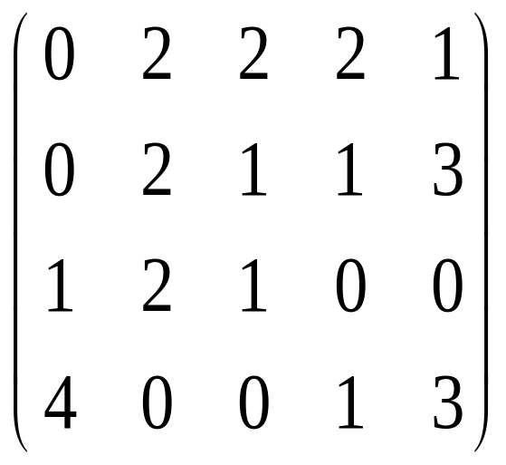
Example
This is a 4 by 5 matrix
The dispatch people will be interested in the
numbers:
4 rows
5 columns

Slide 6
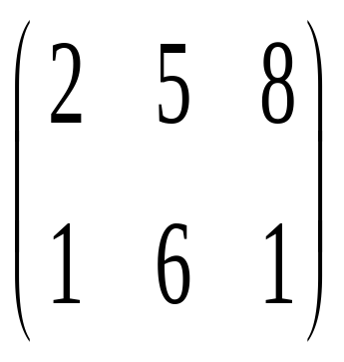
Definition
A matrix is defined by its order which is always
number of rows by number of columns
R
X
C
3 columns
2 rows
2 X 3 matrix

Slide 7
Exercise
Consider the network below showing the roads connecting four towns and the distances, in km, along each road.
B
10
5
16
C
14
8
A
12
D
(i) Write down the information in matrix form.
(ii) What is the order of the matrix?

Slide 8
Solution
(i) This information could be put into a table:
to
km | A | B | C | D
A | 0 | 5 | 14 | 12
B | 5 | 0 | 10 | 16
C | 14 | 10 | 0 | 8
D | 12 | 16 | 8 | 0
from

Slide 9
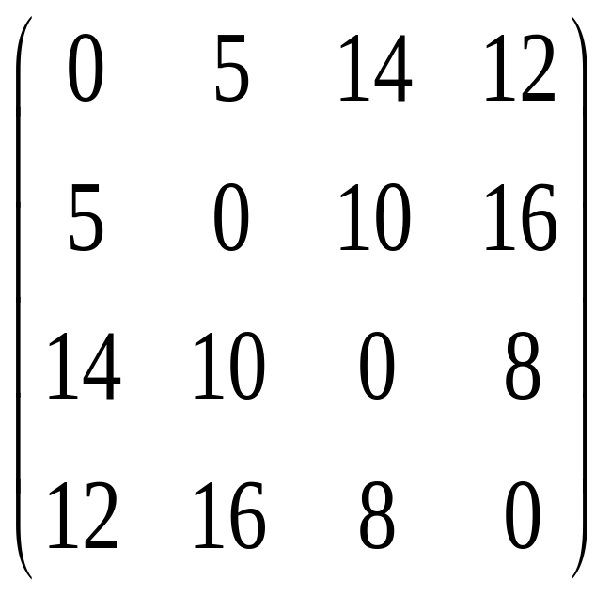
Solution
and then into a matrix:
(ii) order: R X C
= 4 X 4 matrix.
This is called a square matrix.

Slide 10
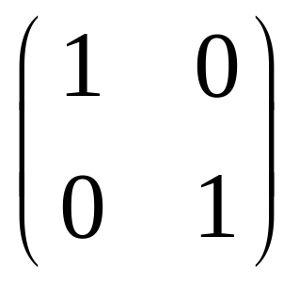
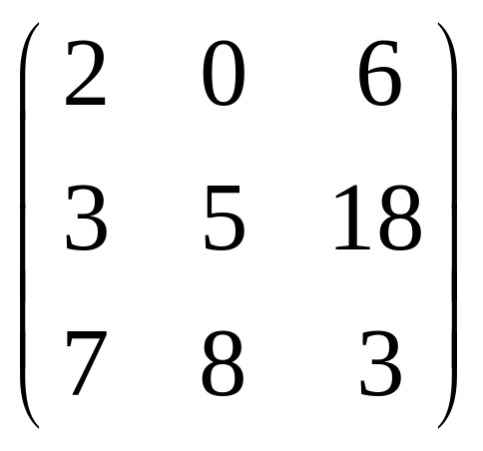
Definition
A square matrix has the same number of rows
as columns. Its order is of the form M x M.
Examples:
2 X 2 square matrix
3 X 3 square matrix

Slide 11
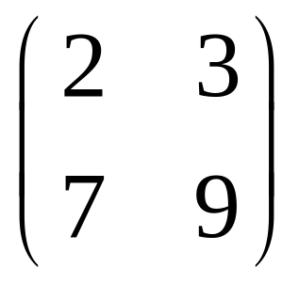

Definition
The transpose of a matrix M, called M^{T}, is
found by interchanging the rows and columns.
Example:
M =
row
row
2
3
7
9
column

Slide 12
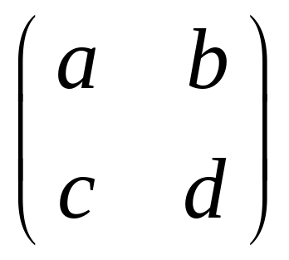
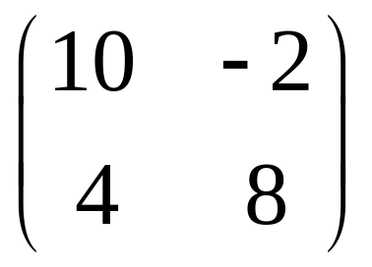
Definition
Equal Matrices: Two matrices are equal if their
corresponding entries (elements) are equal.
Example: If
=
a = 10
b = -2
c = 4
d = 8

Slide 13
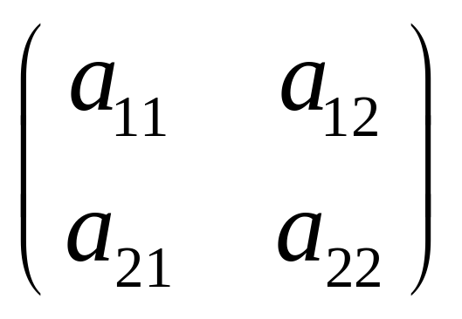
Definition
Entries, or elements, of a matrix are named
according to their position in the matrix. The
row is named first and the column second.
Example: entry a₂₃ is the element on row 2, column 3.
Example: here are the entries for a 2 x 2 matrix.

Slide 14

Example
In the following matrix, name the position of the colored entry.
(i)
1
2
5
-7
Remember: row first
row 2
a₂
Column second
column 1
The entry is a₂₁

Slide 15

Example
In the following matrix, name the position of
the colored entry.
(ii)
c d e f
o p q r
row 1, column 3
The entry is a₁₃

Slide 16
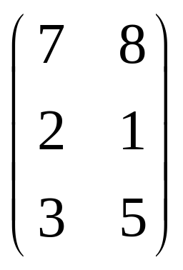
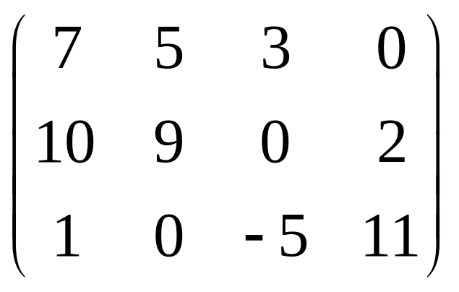
Example
In the following matrices, identify the value of the entry for the given position.
row 3, column 2
= 5
a₃₂
row 2, column 4
= 2
a₂₄

Slide 17
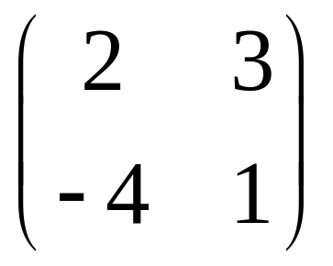
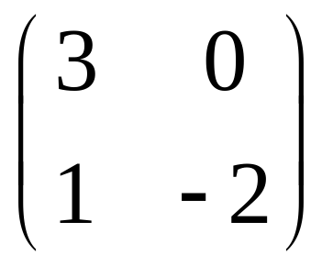
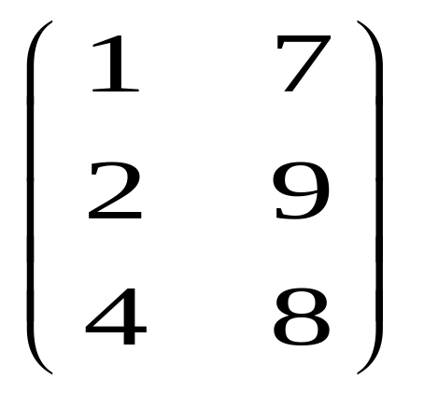
Definition
Addition and Subtraction: Matrices can be added or subtracted if they have the same order. Corresponding entries are added (or subtracted).
Example: A = B =
C =

Slide 18


Example
Find, if possible,
(i) A + B (ii) A – C (iii) B - A
(i) A + B
orders are the same. Yes, can add them.
2 X 2 + 2 X 2
+
2 + 3
3 + 0
=
-4 + 1
1 + -2
=
5
3
-3
-1

Slide 19
(ii) A – C
2 X 2 3 X 2
orders are different
A – C not possible.
(iii) B – A
2 X 2 2 X 2
orders are the same
Yes, B – A possible.
–
3-2
0-3
=
1- ⁻4
-2-1
1
-3
=
5
-3

Slide 20
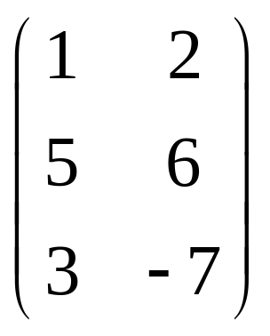
Definition
Multiplication by a scalar: to multiply a matrix
by a scalar ( a number) multiply each entry by
the number.
Example: S =
Find 3S

Slide 21


(i)
3
=
=
3x1
3x2
3x5
3x6
3x3
3x-7
3
6
15
18
9
–21

Slide 22
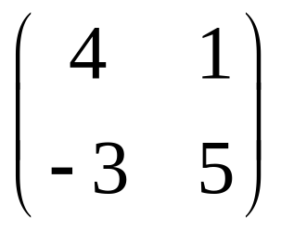
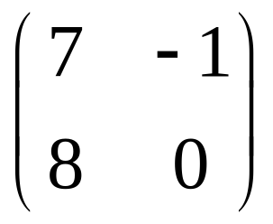
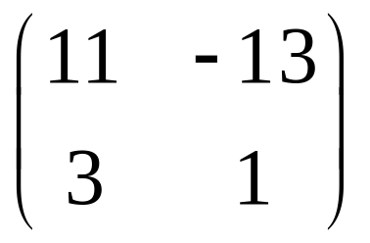
Exercise
Let
A = B = C =
Find
(i) 3A – 2B^{T}
(ii) a 2 x 2 matrix so that 2A – 3X = C

Slide 23
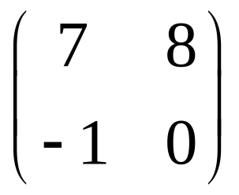
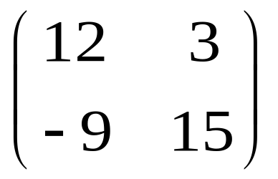
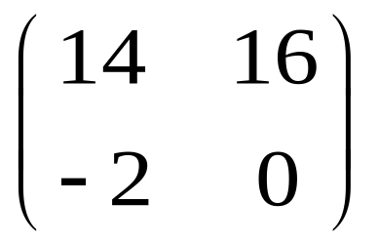
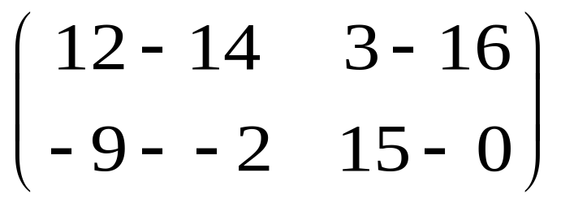
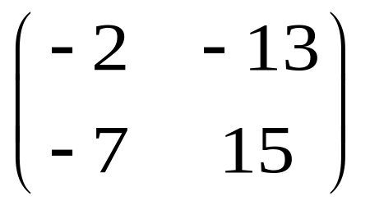
B = =
B^{T}
3 - 2
= -
=
=

Slide 24
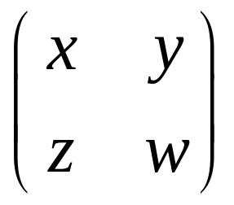
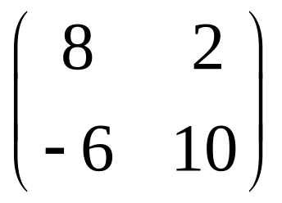
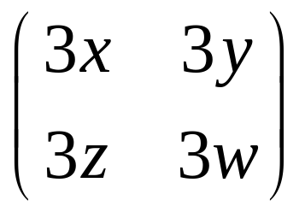
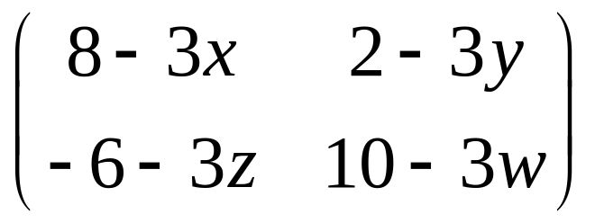
X is 2 X 2. Let X =
2 - 3 =
–
=
=
These are equal matrices, so

Slide 25
A little algebra
8 – 3x = 11
– 3x = 11– 8
– 3x = 3
x = – 1
2 – 3y = – 13
– 3y = – 15
y = 5
– 6 – 3z = 3
– 3z = 9
z = – 3
10 – 3w = 1
– 3w = – 9
w = 3

Slide 26
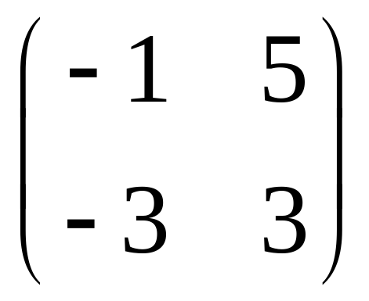
The matrix X is:

Slide 27
Definition
Multiplication of Matrices: multiply each row
of the first matrix by each column of the
second.
This is called the Row X Column method.
To do this, the number of columns in the first
matrix must be equal to the number of rows
in the second.

Slide 28
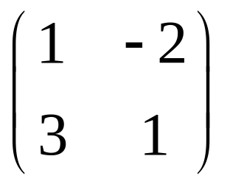
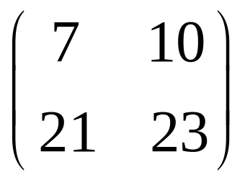
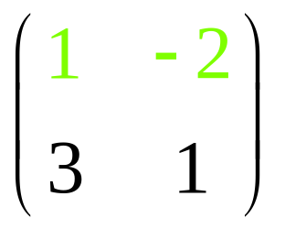
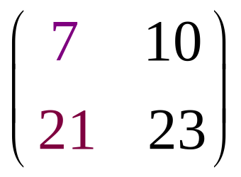
Example
Multiply the following matrices, if possible.
Row 1 by Column 1
2 X 2
2 X 2
equal
Yes, it’s possible.

Slide 29


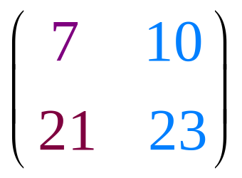
Multiplying and put into position a₁₁
Row 1 by Column 2
1x7 + -2x21
-35
=
Multiply and put into position a₁₂
1x7 + -2x21
1x10 + -2x23
-35
=

Slide 30
Row 2 by Column 1 and put in position a₂₁
-35
-36
=
3x7 + 1x21
42
Row 2 by Column 2 and put in position a₂₂
-35
-36
=
3x10 + 1x23
42
53
Note: 2 X 2 matrix

Slide 31
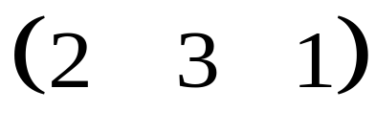
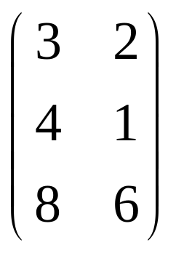
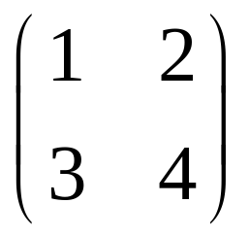
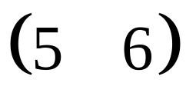
Exercise
Multiply the following matrices, if possible:
(i)
(ii)

Slide 32
Solution
(i)
1 X 3
3 X 2
Equal, it’s possible.
And the resulting matrix will be order 1 X 2

Slide 33
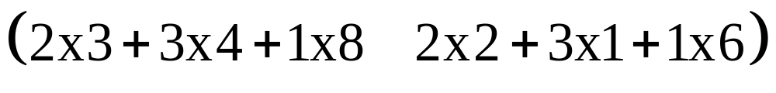
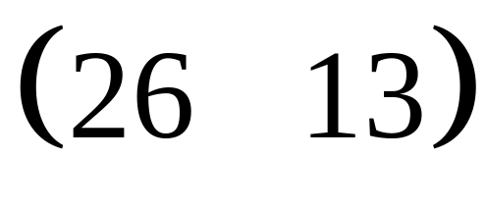
Multiplying:
=
1 X 2
2 X 2
1 X 2
Not equal
Multiplication not possible

Slide 34
Example
A Maths exam paper has 8 questions in Section A
and 4 questions in Section B. Students are to
attempt all questions.
Section A questions are worth 10 marks each and
Section B, 20 marks each.
A student knows that he does not have time to
answer all the questions. He knows that the
following plans work well in the given exam time:

Slide 35
Plan A: Do 8 questions from section A and 2 questions from section B.
Plan B: Do 5 questions from section A and 3 questions from section B.
Plan C: Do 3 questions from section A and 4 questions from section B.
Write the information about the student's plans in a 3 X 2 matrix.
Using matrices, show that the maximum number of marks for this paper is 160.
Which plan will give the student the best possible marks? Justify your answer using matrices.

Slide 36
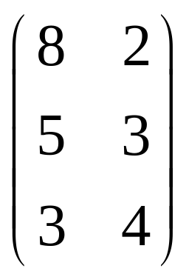
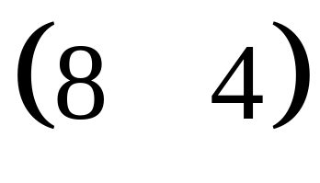
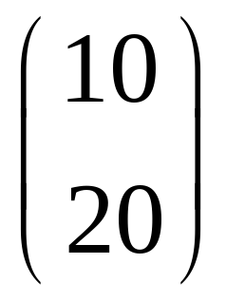
(i) 3 x 2 matrix required:
Section A and B
Plans
sections
marks
1 X 2
2 X 1
can multiply

Slide 37
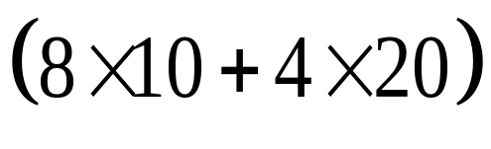
=
=
( 160 )
Maximum number of marks = 160
(iii) There are 3 plans with 2 sections
3 X 2
2 X 1
Section A: 10 mark, Section B:20 mark
3 X 2
2 X 1
plans first

Slide 38
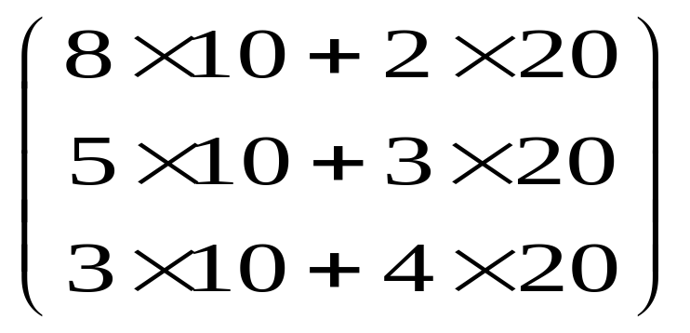

Multiplying:
120
=
110
110
Plan A gives the student the best possible marks.

Slide 39
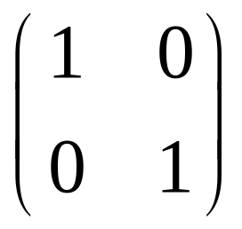

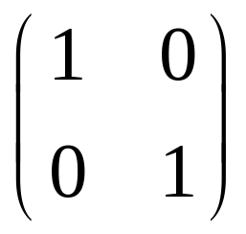

Definition
Identity Matrix: a 2 X 2 identity matrix is
I =
What is an identity matrix?
Example:
Which is identical to
the first one.
2
1
2
1
=
4
3
4
3

Slide 40
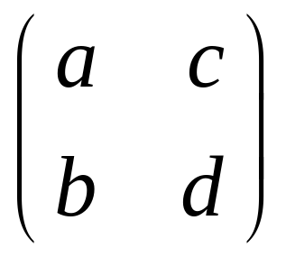
Definition
The Determinant of a 2 X 2 matrix A where
A =
is the number ad – bc.
Some Notation: det(A) = ad – bc

Slide 41
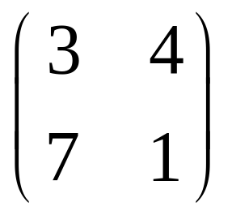
Example
A =
Find the determinant of A
Det(A) =3x1 – 7x4
Det(A) = - 25

Slide 42
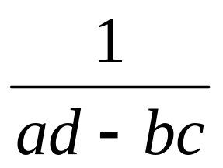
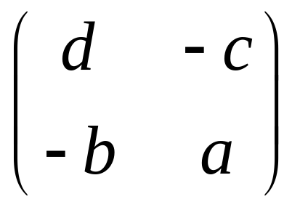
Definition
The inverse of a matrix A, written A⁻¹, is the matrix such that:
A A⁻¹ = Ι = A⁻¹A
If A =
then A⁻¹ =
a and d change position
The determinant of A
c and b change sign

Slide 43
To find the inverse of a matrix
Step 1: Exchange the elements in the leading
diagonal.
Step 2: Change the sign of the other two
elements.
Step 3: Multiply by the reciprocal of the
determinant.

Slide 44




Example
P = Find P⁻¹
Step 1:
Step 2:
Step 3: det(P) = -1x2– -1x3 = 1
P⁻¹ = =
Exchange the elements in the leading diagonal
Change the sign of the other two elements.

Slide 45


check
To check if the answer is correct:
= I
P
P⁻¹
=
=
Yes! It is correct.

Slide 46





Applications
Using matrices to solve simultaneous equations.
Example: Solve using matrices
Step 1: make matrices for the coefficients (numbers) and for the letters as follows:
1
-2
3
=
3
-1
-1

Slide 47






Step 2: pre-multiply by the inverse of the
2 X 2 matrix on both sides of the equation.
Step 3: x = -1 and y = -2
–1
–1
=
-1
-1
-1
-1
=
5
-1
=
-2

Slide 48
Applications: Cryptology
Matrix inverses can be used to encode and decode messages.
To start: Set up a code.
The letters of the English alphabet are given corresponding numbers from 1-26.
The number 27 is used to represent a space between words.
A B C D E F G H I J K L M N O P Q R S T U V W X Y Z
1 2 3 4 5 6 7 8 9 10 11 12 13 14 15 16 17 18 19 20 21 22 23 24 25 26

Slide 49
Secret Code
In this code, the words
SECRET CODE is given by:
Any 2X2 matrix, with positive integers and
where the inverse matrix exists, can be used
as the encoding matrix.
19 5 18 5 20 27 3 15 4 5
27 represents the space between the words.

Slide 50



Let’s use A = as the encoding matrix.
To encode the message SECRET CODE, we need to create a matrix with 2 rows.
The last entry is blank, so we enter 27 for a space.
We are now ready to encode the message.
27

Slide 51


To encode the message, multiply by A:
Encoding
matrix first
=
The encryption for SECRET CODE is
91 24 66 21 80 25 117 30 72 19 101 32

Slide 52
Decoding
To decode a message, simply put it back in
matrix form and multiply on the left with the
inverse matrix A⁻¹
Since only A and A⁻¹ are the only “keys”
needed to encode and decode a message,
it becomes easy to encrypt a message.
The difficulty is in finding the key matrix.

Slide 53

Example
Encoding matrix A =
Use this matrix and the code for the English alphabet above, to encode the message DISCRETE MATHS.
Also, decode
55 70 75 102 22 31 58 85 49 69

Slide 54



(i) DISCRETE MATHS
ENCODE
=
Encoded message:22 31 25 28 28 33 30 35 53 56 41 46 65

Slide 55




(ii) A⁻¹ =
Decode:
=
25 15 21 27 4 9 4 27 9 20
Y
o
u
d
i
d
i
t

Slide 56
You should now be able to
define and use the matrix form.
find the order of a matrix.
label entries and read entry positions.
find the transpose of a matrix.
use equality of matrices to solve problems.
use the operations of matrices.
find inverses of 2X2 matrices.
apply your knowledge to a range of contexts.

